Slide 1
Reinforcement
Learning
Harish Kumar, Michael Bass

Slide 2
Reinforcement
Supervised
Unsupervised

Slide 3





Supervised
Reinforcement
Unsupervised

Slide 4



Supervised
Unsupervised
Reinforcement

Slide 5
Supervised
Unsupervised
Reinforcement

Slide 6


Supervised
Unsupervised
Reinforcement
Cat
Cat
Cat

Slide 7
Reinforcement

Slide 8
R

Slide 9
R

Slide 10
R

Slide 11


Actors
Environment
R

Slide 12

Environment
Actors
R

Slide 13
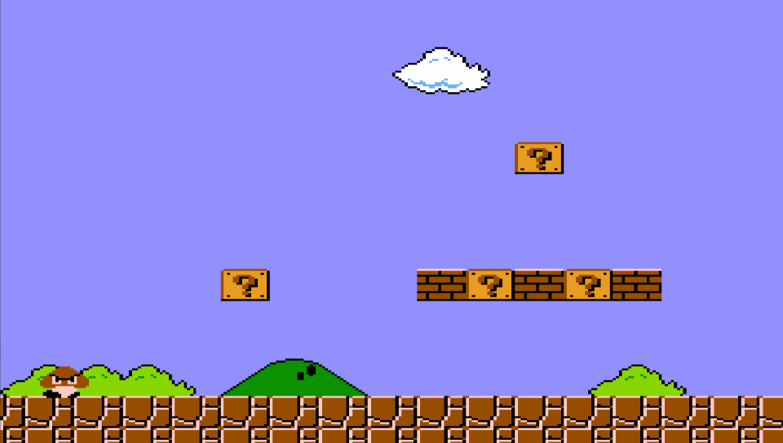
Environment
Actors
R

Slide 14
Actors
Environment
R

Slide 15
Actors
Environment
R

Slide 16
Actors
Environment
R

Slide 17
Actors
Environment
R

Slide 18
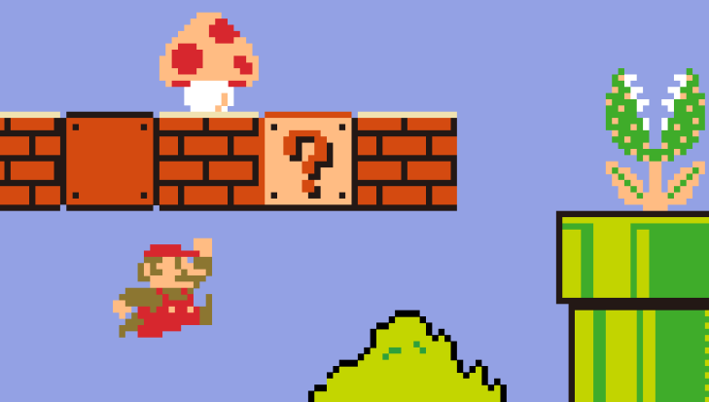

Actors
Actions!
Environment
R

Slide 19
Actors
Actions!
Environment
R

Slide 20
Actors
Actions!
Environment
R

Slide 21
Actors
Actions!
Environment
R

Slide 22

Actors
Actions!
Environment
R

Slide 23
Actors
Actions!
Environment
R

Slide 24
R
Actors
Actions!
Environment

Slide 25
R
Why
?

Slide 26
R

Slide 27



Complex
Environment
Requires
Action
Use Past for
Unseen Situations
?
S
Agent
R

Slide 28
Agent
R

Slide 29
Adapt
Agent
R

Slide 30
Adapt
Agent
R

Slide 31
Adapt
Agent
R

Slide 32
Adapt
Agent
R

Slide 33
Adapt
Agent
R

Slide 34
Adapt
Agent
R

Slide 35
Adapt
Agent
R

Slide 36
Adapt
Correct
Agent
R

Slide 37
Correct
Agent
R

Slide 38
Correct
Who
is the
Agent
Agent
R

Slide 39
Who
is the
Agent
Agent
R

Slide 40
Who
is the
Agent
using System;
using System.Collections.Generic;
using System.Linq;
using System.Text;
using System.Threading.Tasks;
using Windows.UI;
using Windows.UI.Xaml;
using Windows.UI.Xaml.Media;
using Windows.UI.Xaml.Shapes;
namespace Clock
{
public class Slot
{
public Slot(double slotWidth, double slotHieght, int rowId, int columnId)
{
_turnsRemaining = 0;
_rowId = rowId;
_columnId = columnId;
_rectangle = new Rectangle();
_rectangle.Margin = new Thickness(_columnId * slotWidth, _rowId * slotHieght, 0, 0);
_rectangle.Stroke = new SolidColorBrush(Colors.Black);
_rectangle.StrokeThickness = 3;
_rectangle.Stroke.Opacity = 0;
_rectangle.Fill = new SolidColorBrush(Colors.Black);
_rectangle.Fill.Opacity = 0;
_slotWidth = slotWidth;
_slotHeight = slotHieght;
_rectangle.Width = _slotWidth;
_rectangle.Height = _slotHeight;
_rectangle.HorizontalAlignment = HorizontalAlignment.Left;
_rectangle.VerticalAlignment = VerticalAlignment.Top;
_picture = null;
_filled = false;
}
public Rectangle GetRectangle() { return _rectangle; }
private const int _factor = 5;
private int _rowId;
private int _columnId;
private double _slotWidth;
private double _slotHeight;
private Picture _picture;
private bool _filled;
private Rectangle _rectangle;
private int _turnsRemaining;
}
}
using Windows.UI;
using Windows.UI.Xaml.Shapes;
using Windows.UI.Xaml.Media.Imaging;
using Windows.UI.ViewManagement;
namespace Clock
{
/// <summary>
/// An empty page that can be used on its own or navigated to within a Frame.
/// </summary>
///
public sealed partial class MainPage : Page
{
const double _screenWidth = 1080;
const double _screenHeight = 1920;
const int _numberOfClockColumns = 9;
const int _numberOfClockRows = 2;
const int _numberOfColumns = 10;
const int _numberOfRows = 16;
/*
const double _screenWidth = 1920;
const double _screenHeight = 1080;
const int _numberOfClockColumns = 7;
const int _numberOfClockRows = 2;
const int _numberOfColumns = 15;
const int _numberOfRows = 10;
*/
string s = "";
const int _boundUp = 90;
const int _boundLeft = 0;
const int _numberOfKimKardashianPictures = 150;
private double _clockHeight;
//const int _numberOfClockColumns = 14;
//const int _numberOfClockRows = 4;
//const int _numberOfColumns = 30;
//const int _numberOfRows = 20;
const int _movesPerClockMove = 200;
List<List<Slot>> _slots;
List<Slot> _emptySlots;
List<Picture> _pictures;
Random _random;
public MainPage()
{
_clockHeight = clock.Height;
_slots = new List<List<Slot>>();
_emptySlots = new List<Slot>();
_pictures = new List<Picture>();
_random = new Random();}
}
}
using System;
using System.Collections.Generic;
using System.Linq;
using System.Text;
namespace Clock
{
public class Picture
{
public Picture(List<List<Slot>> allSlots)
{
_rowId = 0;
_columnId = 0;
_rowWidth = 0;
_columnWidth = 0;
_pictureName = "";
_allSlots = allSlots;
_bitmapImage = null;
_imageBrush = null;
_isClock = false;
}
public async Task SetPicture(int rowId, int columnId, int rowWidth, int columnWidth,
string pictureName, List<Slot> emptySlots)
{
_pictureName = pictureName;
_imageBrush = new ImageBrush();
_imageBrush.Opacity = 0;
_bitmapImage = new BitmapImage();
_bitmapImage.UriSource = new Uri("ms-appx:///Assets/Images/" + _pictureName);
_imageBrush.ImageSource = _bitmapImage;
_rowId = rowId;
_columnId = columnId;
_rowWidth = rowWidth;
_columnWidth = columnWidth;
for (int i = 0; i < _rowWidth; i++)
{
for(int j = 0; j < _columnWidth; j++)
{
_allSlots[_rowId + i][_columnId + j].SetPicture(this, emptySlots);
}
}
await _allSlots[_rowId][_columnId].ShowPicture(_rowWidth, _columnWidth);
}
await _allSlots[_rowId][_columnId].UnShowPicture();
_bitmapImage = null;
_imageBrush = null;
}
private int _columnId;
private int _rowWidth;
private int _columnWidth;
private string _pictureName;
private List<List<Slot>> _allSlots;
BitmapImage _bitmapImage;
ImageBrush _imageBrush;
bool _isClock;
}
}
Agent
Actions
R

Slide 41
Who
is the
Agent
Agent
Actions
R

Slide 42
Actions
R

Slide 43
Actions
R

Slide 44
Actions
R

Slide 45
Actions
R

Slide 46
Actions
R

Slide 47
Actions
R

Slide 48
Actions
R

Slide 49
Environment
Actions
R

Slide 50
Environment
Actions
R

Slide 51
Environment
R

Slide 52

Environment
R

Slide 53
Environment
R

Slide 54
Environment
R

Slide 55

Environment
R

Slide 56
Environment
R

Slide 57
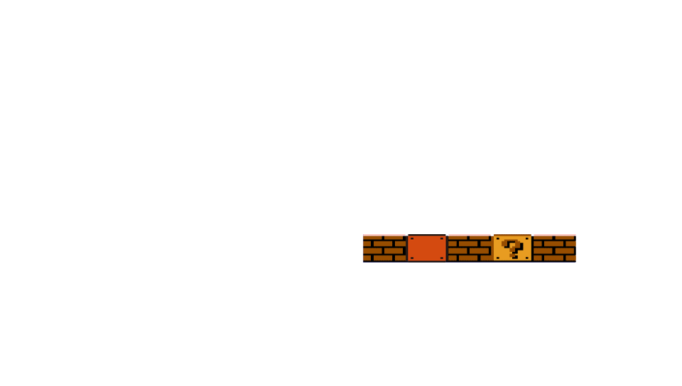

Environment
R

Slide 58
Environment
R

Slide 59
Environment
R

Slide 60
Environment
R

Slide 61
Environment
R

Slide 62

Environment
R

Slide 63
Environment
R

Slide 64
Environment
R

Slide 65
R

Slide 66
R

Slide 67
R

Slide 68
R
The Math!

Slide 69
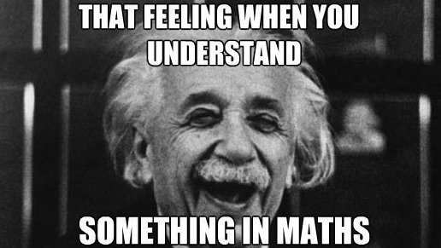
R
The Math!

Slide 70
R
The Math!

Slide 71
R
The Math!

Slide 72
R

Slide 73
R

Slide 74

Set of Environment States: S
R

Slide 75
Set of Environment States: S
R

Slide 76
Set of Environment States: S
R

Slide 77
Set of Environment States: S
R

Slide 78
Set of Environment States: S
R

Slide 79

Set of Environment States: S
R

Slide 80
Set of Environment States: S
R

Slide 81
Set of Environment States: S
R

Slide 82
Set of Environment States: S
R

Slide 83
Set of Environment States: S
R

Slide 84
Set of Environment States: S
R

Slide 85
Set of Environment States: S
R

Slide 86
Set of Permitted Actions: A
S
Set of Environment States: S
R

Slide 87
Set of Permitted Actions: A
S
Set of Environment States: S
R

Slide 88
Set of Permitted Actions: A
S
Set of Environment States: S
R

Slide 89
Set of Permitted Actions: A
S
Set of Environment States: S
R

Slide 90
Set of Permitted Actions: A
S
Set of Environment States: S
R

Slide 91
Set of Permitted Actions: A
S
Set of Environment States: S
R

Slide 92
S
Set of Environment States: S
Set of Permitted Actions: A
R

Slide 93
State Transition Probability: P_{a}(s, s’)
S
A
Set of Environment States: S
Set of Permitted Actions: A
R

Slide 94


State Transition Probability: P_{a}(s, s’)
S
A
Set of Environment States: S
Set of Permitted Actions: A
R

Slide 95
State Transition Probability: P_{a}(s, s’)
S
A
Set of Environment States: S
Set of Permitted Actions: A
R

Slide 96
State Transition Probability: P_{a}(s, s’)
S
A
Set of Environment States: S
Set of Permitted Actions: A
R

Slide 97
State Transition Probability: P_{a}(s, s’)
S
A
Set of Environment States: S
Set of Permitted Actions: A
R

Slide 98

State Transition Probability: P_{a}(s, s’)
S
A
Set of Environment States: S
Set of Permitted Actions: A
R

Slide 99
State Transition Probability: P_{a}(s, s’)
S
A
Set of Environment States: S
Set of Permitted Actions: A
R

Slide 100
State Transition Probability: P_{a}(s, s’)
S
A
Set of Environment States: S
Set of Permitted Actions: A
R

Slide 101
S
A
Set of Environment States: S
Set of Permitted Actions: A
State Transition Probability: P_{a}(s, s’)
R

Slide 102
Immediate Reward Distribution: R_{a}(s, s’)
S
A
P_{a}(s,s’)
Set of Environment States: S
Set of Permitted Actions: A
State Transition Probability: P_{a}(s, s’)
R

Slide 103

Immediate Reward Distribution: R_{a}(s, s’)
S
A
P_{a}(s,s’)
Set of Environment States: S
Set of Permitted Actions: A
State Transition Probability: P_{a}(s, s’)
R

Slide 104
Immediate Reward Distribution: R_{a}(s, s’)
S
A
P_{a}(s,s’)
Set of Environment States: S
Set of Permitted Actions: A
State Transition Probability: P_{a}(s, s’)
R

Slide 105
Immediate Reward Distribution: R_{a}(s, s’)
S
A
P_{a}(s,s’)
Set of Environment States: S
Set of Permitted Actions: A
State Transition Probability: P_{a}(s, s’)
R

Slide 106
Immediate Reward Distribution: R_{a}(s, s’)
S
A
P_{a}(s,s’)
Set of Environment States: S
Set of Permitted Actions: A
State Transition Probability: P_{a}(s, s’)
R

Slide 107
Immediate Reward Distribution: R_{a}(s, s’)
S
A
P_{a}(s,s’)
Set of Environment States: S
Set of Permitted Actions: A
State Transition Probability: P_{a}(s, s’)
R

Slide 108
Immediate Reward Distribution: R_{a}(s, s’)
S
A
P_{a}(s,s’)
Set of Environment States: S
Set of Permitted Actions: A
State Transition Probability: P_{a}(s, s’)
R

Slide 109
Immediate Reward Distribution: R_{a}(s, s’)
S
A
P_{a}(s,s’)
Set of Environment States: S
Set of Permitted Actions: A
State Transition Probability: P_{a}(s, s’)
R

Slide 110
Immediate Reward Distribution: R_{a}(s, s’)
S
A
P_{a}(s,s’)
Set of Environment States: S
Set of Permitted Actions: A
State Transition Probability: P_{a}(s, s’)
R

Slide 111


Immediate Reward Distribution: R_{a}(s, s’)
S
A
P_{a}(s,s’)
Set of Environment States: S
Set of Permitted Actions: A
State Transition Probability: P_{a}(s, s’)
R

Slide 112


Immediate Reward Distribution: R_{a}(s, s’)
S
A
P_{a}(s,s’)
Set of Environment States: S
Set of Permitted Actions: A
State Transition Probability: P_{a}(s, s’)
R

Slide 113
Immediate Reward Distribution: R_{a}(s, s’)
S
A
P_{a}(s,s’)
Set of Environment States: S
Set of Permitted Actions: A
State Transition Probability: P_{a}(s, s’)
R

Slide 114
S
A
P_{a}(s,s’)
Set of Environment States: S
Set of Permitted Actions: A
State Transition Probability: P_{a}(s, s’)
Immediate Reward Distribution: R_{a}(s, s’)
R

Slide 115
How Does It All Fit Together
S
A
P_{a}(s,s’)
R_{a}(s,s’)
Set of Environment States: S
Set of Permitted Actions: A
State Transition Probability: P_{a}(s, s’)
Immediate Reward Distribution: R_{a}(s, s’)
R

Slide 116
Q-Learning
How Does It All Fit Together
S
A
P_{a}(s,s’)
R_{a}(s,s’)
Set of Environment States: S
Set of Permitted Actions: A
State Transition Probability: P_{a}(s, s’)
Immediate Reward Distribution: R_{a}(s, s’)
R

Slide 117
Q-Learning
How Does It All Fit Together
S
A
P_{a}(s,s’)
R_{a}(s,s’)
Set of Environment States: S
Set of Permitted Actions: A
State Transition Probability: P_{a}(s, s’)
Immediate Reward Distribution: R_{a}(s, s’)
R

Slide 118
Q-Learning
Q
S
A
P_{a}(s,s’)
R_{a}(s,s’)
Set of Environment States: S
Set of Permitted Actions: A
State Transition Probability: P_{a}(s, s’)
Immediate Reward Distribution: R_{a}(s, s’)
R

Slide 119
Q-Learning
Q
S
A
P_{a}(s,s’)
R_{a}(s,s’)
Set of Environment States: S
Set of Permitted Actions: A
State Transition Probability: P_{a}(s, s’)
Immediate Reward Distribution: R_{a}(s, s’)
R

Slide 120
Q
S
A
P_{a}(s,s’)
R_{a}(s,s’)
Set of Environment States: S
Set of Permitted Actions: A
State Transition Probability: P_{a}(s, s’)
Immediate Reward Distribution: R_{a}(s, s’)
R

Slide 121
Q
(s_{t}, a_{t})
S
A
P_{a}(s,s’)
R_{a}(s,s’)
Set of Environment States: S
Set of Permitted Actions: A
State Transition Probability: P_{a}(s, s’)
Immediate Reward Distribution: R_{a}(s, s’)
R

Slide 122
Q
(s_{t}, a_{t})
S
A
P_{a}(s,s’)
R_{a}(s,s’)
Set of Environment States: S
Set of Permitted Actions: A
State Transition Probability: P_{a}(s, s’)
Immediate Reward Distribution: R_{a}(s, s’)
R

Slide 123
Q
(s_{t}, a_{t})
S
A
P_{a}(s,s’)
R_{a}(s,s’)
Set of Environment States: S
Set of Permitted Actions: A
State Transition Probability: P_{a}(s, s’)
Immediate Reward Distribution: R_{a}(s, s’)
R

Slide 124
Q
(s_{t}, a_{t})
S
A
P_{a}(s,s’)
R_{a}(s,s’)
Set of Environment States: S
Set of Permitted Actions: A
State Transition Probability: P_{a}(s, s’)
Immediate Reward Distribution: R_{a}(s, s’)
R

Slide 125
Q
(s_{t}, a_{t})
S
A
P_{a}(s,s’)
R_{a}(s,s’)
Set of Environment States: S
Set of Permitted Actions: A
State Transition Probability: P_{a}(s, s’)
Immediate Reward Distribution: R_{a}(s, s’)
R

Slide 126
Q
(s_{t}, a_{t})
Immediate Reward
&
Future Potential
S
A
P_{a}(s,s’)
R_{a}(s,s’)
Set of Environment States: S
Set of Permitted Actions: A
State Transition Probability: P_{a}(s, s’)
Immediate Reward Distribution: R_{a}(s, s’)
R

Slide 127
Q
(s_{t}, a_{t})
S
A
P_{a}(s,s’)
R_{a}(s,s’)
Set of Environment States: S
Set of Permitted Actions: A
State Transition Probability: P_{a}(s, s’)
Immediate Reward Distribution: R_{a}(s, s’)
R

Slide 128
Q
(s_{t}, a_{t})
Q^{t+1}
(s_{t}, a_{t}) = (1-α)
Q^{t}
(s_{t}, a_{t}) +α(r_{t} + γ
Q^{t}
(s_{t}, a_{t}))
S
A
P_{a}(s,s’)
R_{a}(s,s’)
Set of Environment States: S
Set of Permitted Actions: A
State Transition Probability: P_{a}(s, s’)
Immediate Reward Distribution: R_{a}(s, s’)
R

Slide 129
Q
(s_{t}, a_{t})
Q^{t+1}
(
,
)
Q^{t+1}
(s_{t}, a_{t}) = (1-α)
Q^{t}
(s_{t}, a_{t}) +α(r_{t} + γ max_{i}(
Q^{t}
(s_{t+1}, a_{i})))
S
A
P_{a}(s,s’)
R_{a}(s,s’)
Set of Environment States: S
Set of Permitted Actions: A
State Transition Probability: P_{a}(s, s’)
Immediate Reward Distribution: R_{a}(s, s’)
R

Slide 130
Q^{t+1}
(
,
)
Q^{t+1}
(s_{t}, a_{t}) = (1-α)
Q^{t}
(s_{t}, a_{t}) +α(r_{t} + γ max_{i}(
Q^{t}
(s_{t+1}, a_{i})))
S
A
P_{a}(s,s’)
R_{a}(s,s’)
Set of Environment States: S
Set of Permitted Actions: A
State Transition Probability: P_{a}(s, s’)
Immediate Reward Distribution: R_{a}(s, s’)
R

Slide 131
Q^{t+1}
(
,
)
S
A
P_{a}(s,s’)
R_{a}(s,s’)
Set of Environment States: S
Set of Permitted Actions: A
State Transition Probability: P_{a}(s, s’)
Immediate Reward Distribution: R_{a}(s, s’)
R

Slide 132
(1-α)
Q^{t}
(
,
)
+
α(
+ γ max
(
Q^{t}
(
,
)))
Q^{t+1}
(
,
)
S
A
P_{a}(s,s’)
R_{a}(s,s’)
Set of Environment States: S
Set of Permitted Actions: A
State Transition Probability: P_{a}(s, s’)
Immediate Reward Distribution: R_{a}(s, s’)
R

Slide 133
(1-α)
Q^{t}
(
,
)
Q^{t+1}
(
,
)
=
+
α(
+ γ max
(
Q^{t}
(
,
)))
S
A
P_{a}(s,s’)
R_{a}(s,s’)
Set of Environment States: S
Set of Permitted Actions: A
State Transition Probability: P_{a}(s, s’)
Immediate Reward Distribution: R_{a}(s, s’)
R

Slide 134
Could I Know Every?
(1-α)
Q^{t}
(
,
)
Q^{t+1}
(
,
)
=
(
,
+
)
α(
+ γ max
(
Q^{t}
(
,
)))
S
A
P_{a}(s,s’)
R_{a}(s,s’)
Set of Environment States: S
Set of Permitted Actions: A
State Transition Probability: P_{a}(s, s’)
Immediate Reward Distribution: R_{a}(s, s’)
R

Slide 135
Could I Know Every?
(
,
)
S
A
P_{a}(s,s’)
R_{a}(s,s’)
Set of Environment States: S
Set of Permitted Actions: A
State Transition Probability: P_{a}(s, s’)
Immediate Reward Distribution: R_{a}(s, s’)
R

Slide 136
Could I Know Every?
(
,
)
S
A
P_{a}(s,s’)
R_{a}(s,s’)
Set of Environment States: S
Set of Permitted Actions: A
State Transition Probability: P_{a}(s, s’)
Immediate Reward Distribution: R_{a}(s, s’)
R

Slide 137
NO
(
,
)
S
A
P_{a}(s,s’)
R_{a}(s,s’)
Set of Environment States: S
Set of Permitted Actions: A
State Transition Probability: P_{a}(s, s’)
Immediate Reward Distribution: R_{a}(s, s’)
R

Slide 138

Approximator Function
(
,
)
S
A
P_{a}(s,s’)
R_{a}(s,s’)
Set of Environment States: S
Set of Permitted Actions: A
State Transition Probability: P_{a}(s, s’)
Immediate Reward Distribution: R_{a}(s, s’)
R

Slide 139

R

Slide 140
Code Demonstration
R

Slide 141
Thank You!
Code Demonstration
R

Slide 142
Thank You!
Code Demonstration
Reinforcement Learning

Slide 143
Thank You!
Reinforcement Learning
Code Demonstration
Questions?

Slide 144
Thank You!
Reinforcement Learning
Code Demonstration
Questions?

Slide 145
Thank You!
Questions?
Reinforcement Learning
Code Demonstration

